Slide 1
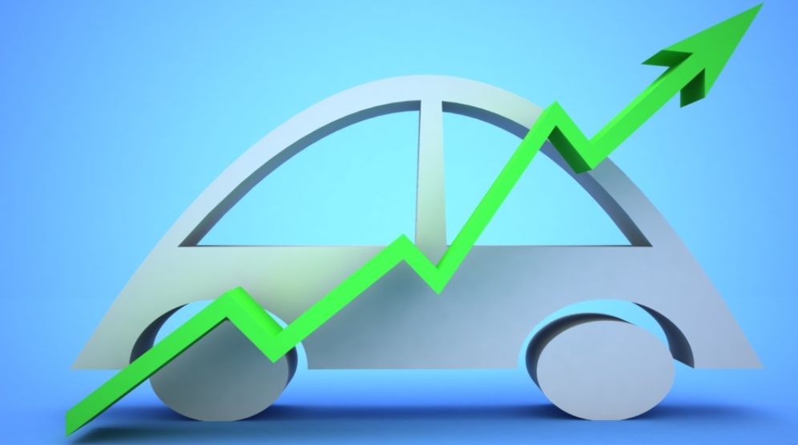
CAR PRICE PREDICTION MODEL
Submitted by-Vipin Kumar

Slide 2
Car Price Prediction
With the covid 19 impact in the market, we have seen lot of changes in the car market. Now some cars are in demand hence making them costly and some are not in demand hence cheaper. One of our clients works with small traders, who sell used cars. With the change in market due to covid 19 impact, our client is facing problems with their previous car price valuation machine learning models. So, they are looking for new machine learning models from new data. We have to make car price valuation model. This project contains two phase.
Data Collection :You have to scrape at least 5000 used cars data. You can scrape more data as well, it’s up to you. more the data better the model In this section You need to scrape the data of used cars from websites (Olx, cardekho, Cars24 etc.) You need web scraping for this. You have to fetch data for different locations. The number of columns for data doesn’t have limit, it’s up to you and your creativity. Generally, these columns are Brand, model, variant, manufacturing year, driven kilometers, fuel, number of owners, location and at last target variable Price of the car. This data is to give you a hint about important variables in used car model. You can make changes to it, you can add or you can remove some columns, it completely depends on the website from which you are fetching the data. Try to include all types of cars in your data for example- SUV, Sedans, Coupe, minivan, Hatchback.
Model Building:After collecting the data, you need to build a machine learning model. Before model building do all data pre-processing steps. Try different models with different hyper parameters and select the best model.

Slide 3
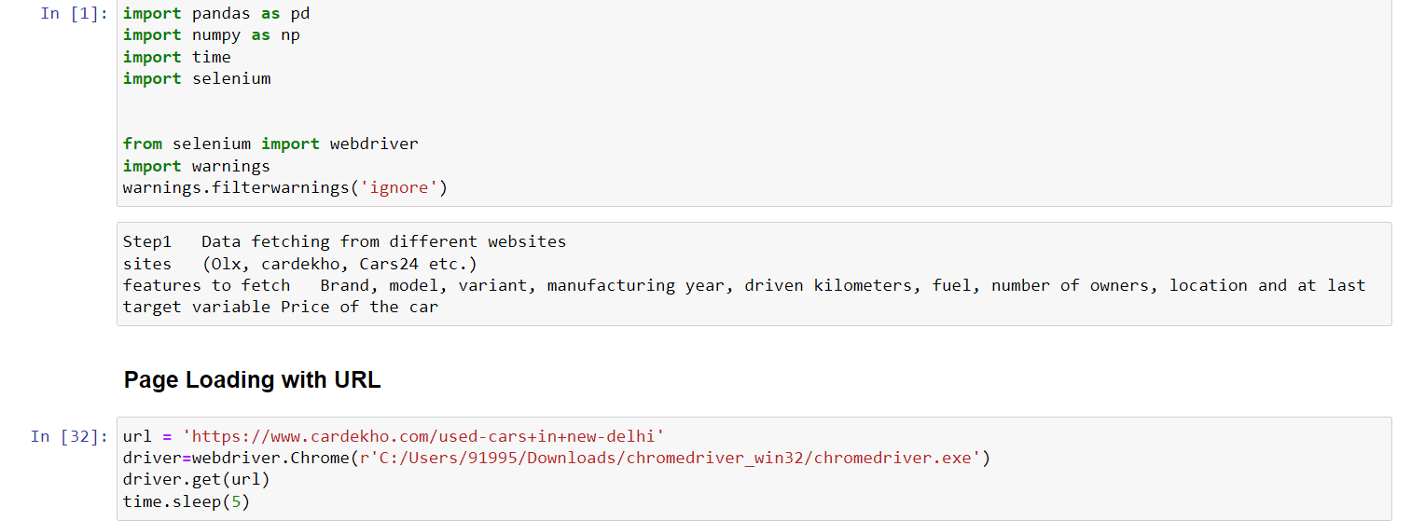
Data Collection
We fetch data from website cardekho.com using selenium.
Importing libraries and site open-Here are steps:
In this step we import libraries and open website link to scrap data.

Slide 4
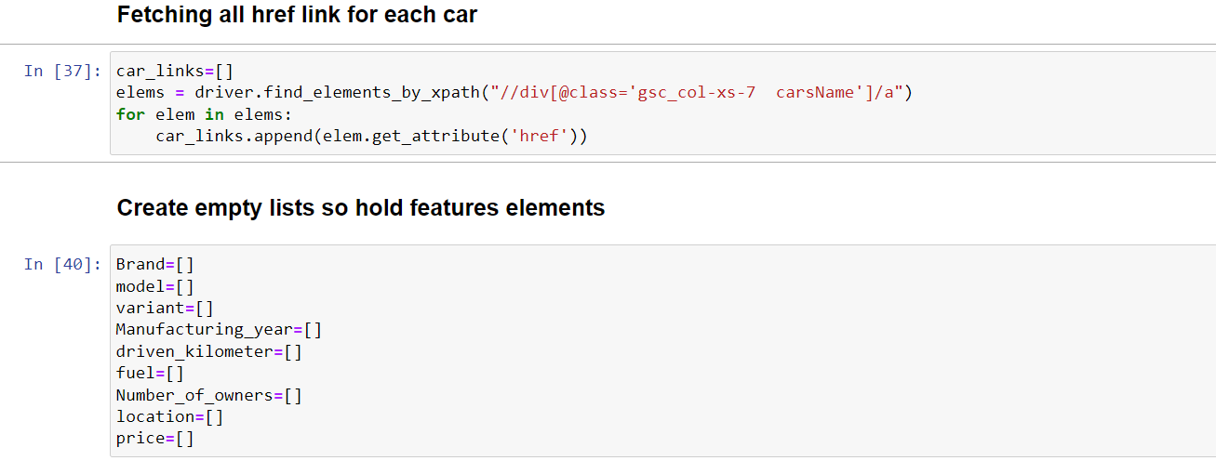
Data Collection
Fetching all href links for each car and create some blank lists:

Slide 5
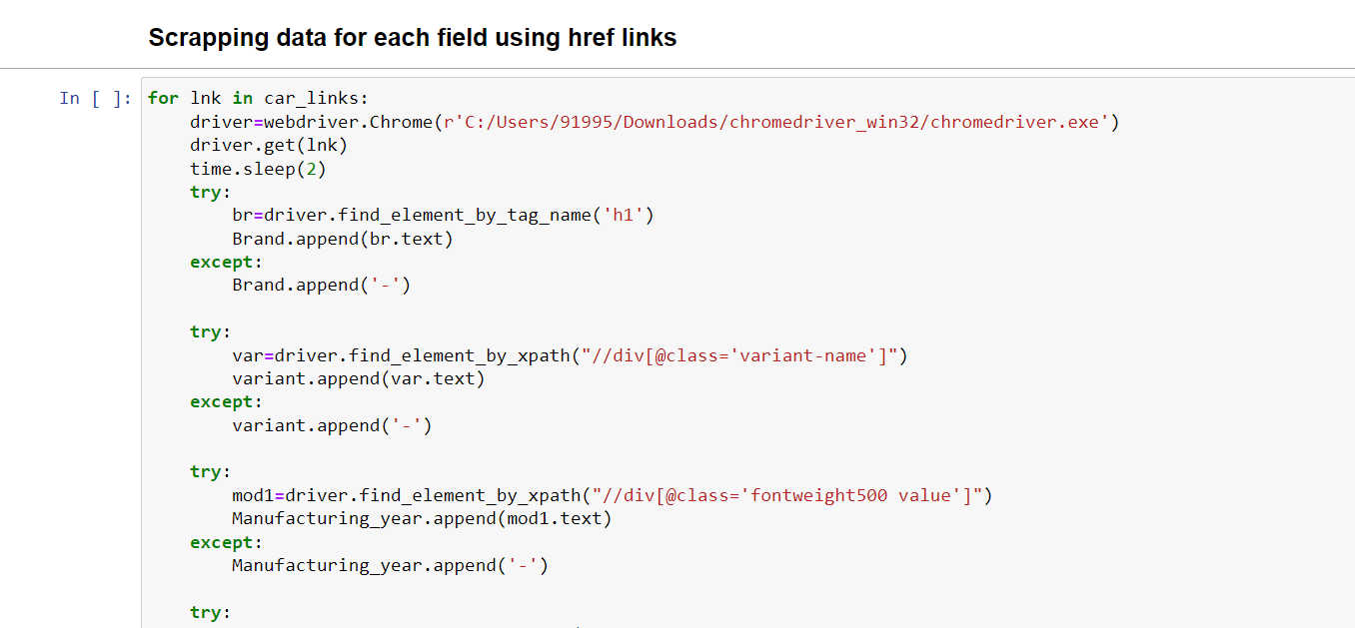
Data Collection
Here we fetching data from each href link one by one and storing into lists, later on we form a data frame using these lists:

Slide 6

Phase2-Model Building
In phase-1 we collect data from site and now we will build a model to predict price..as we have to predict price which is continuous data. So it’s a regression problem.
Here we will use 3 regression algorithms and will choose 1 which is best amongst all.
Linear Regression
Random Forest Regressor
Ada Boost Regressor

Slide 7
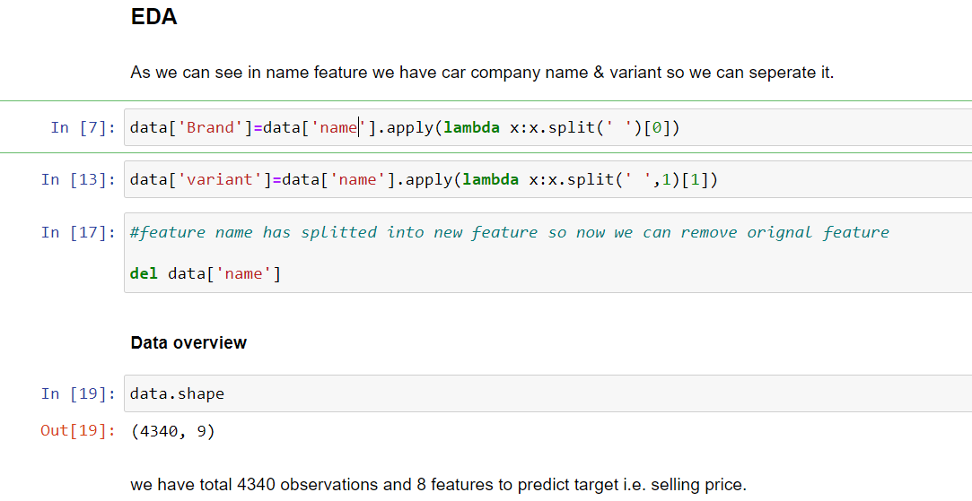
Model Building
EDA: In first site we noticed that in name feature we have car company name & variant so we split it into 2 features.

Slide 8
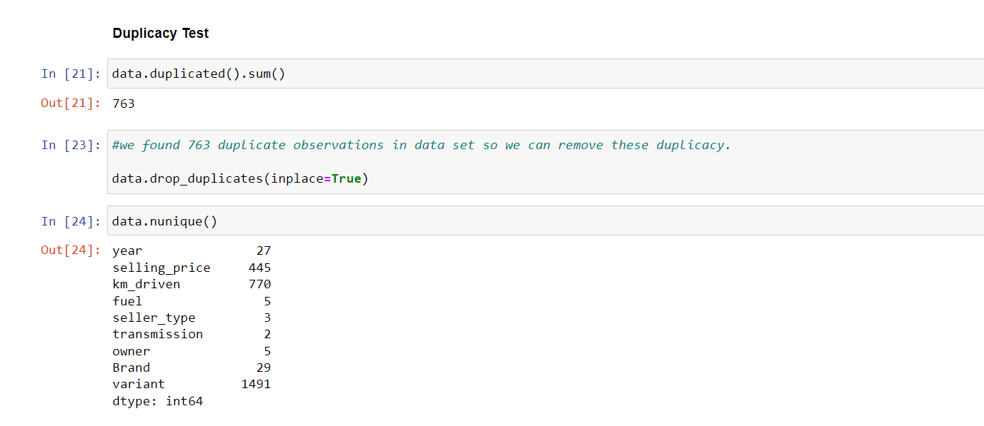
Model Building
Data Cleaning: our data set have 763 duplicate observation so here removed all.

Slide 9
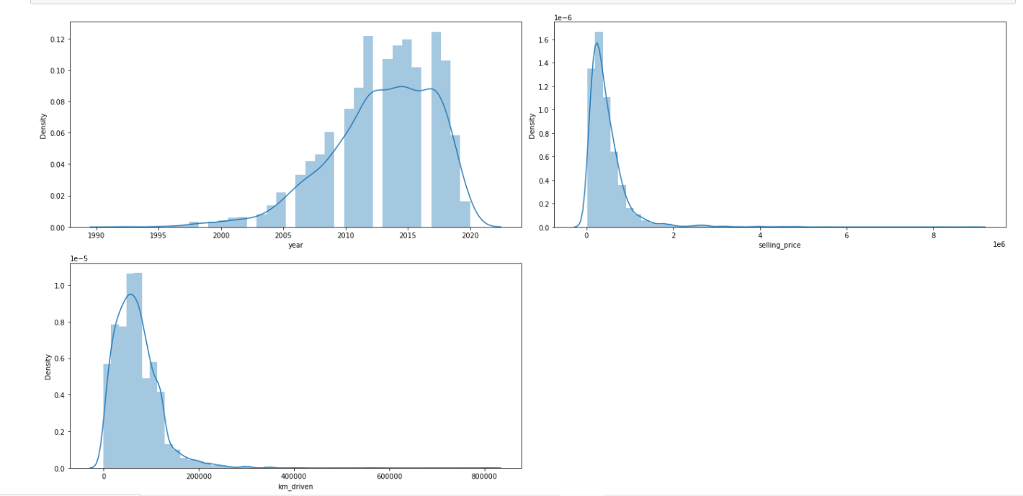
Model Building
EDA: Here we form a dist plot and observe some skewness/outliers in dataset.

Slide 10
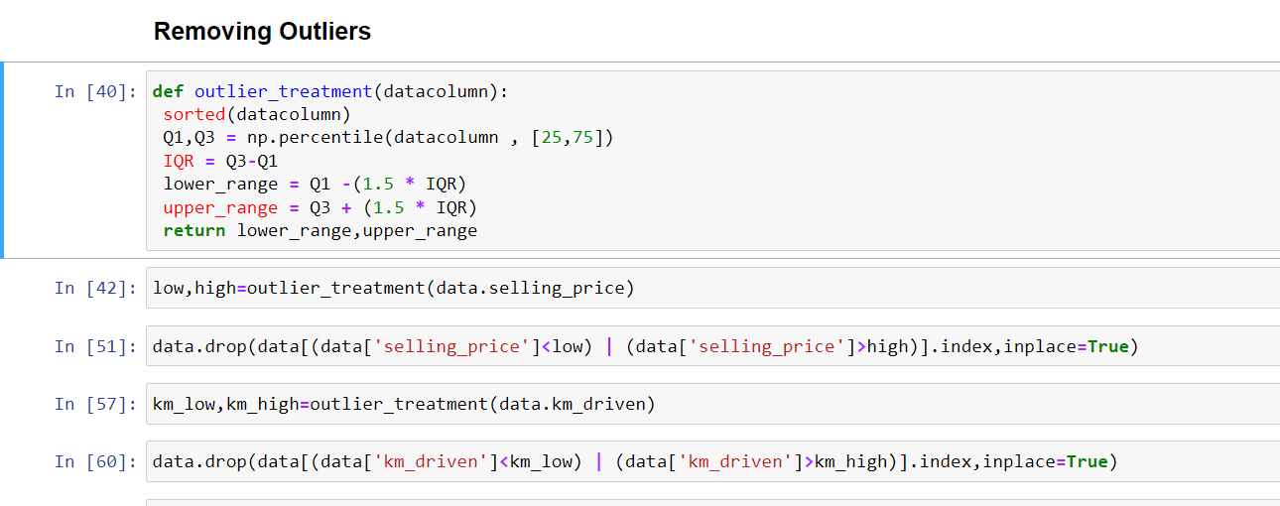
Model Building
No Null Value found in dataset. In below step we remove outliers

Slide 11
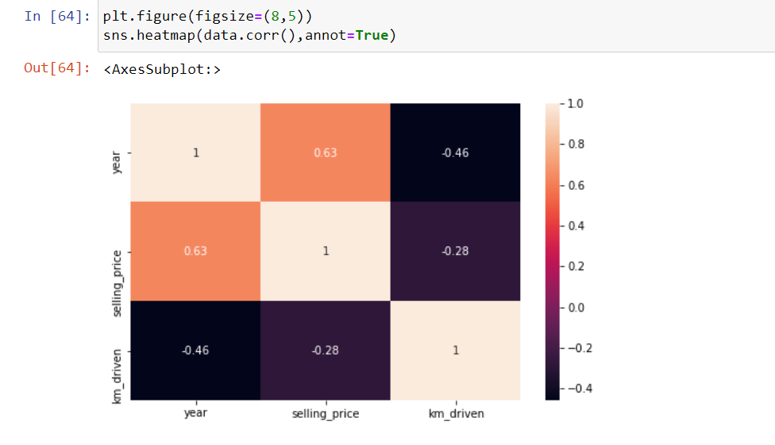
Model Building
Data Correlation-Heatmap Here we form a heatmap and found that given numeric features having good correlation with target=price.

Slide 12
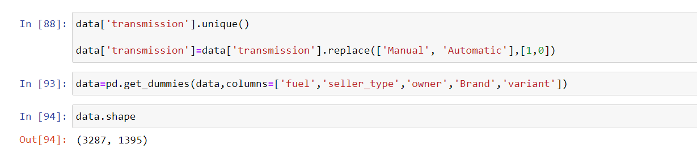
Model Building
We found 6 object data type features in data set so we encode all using one hot encoder.

Slide 13
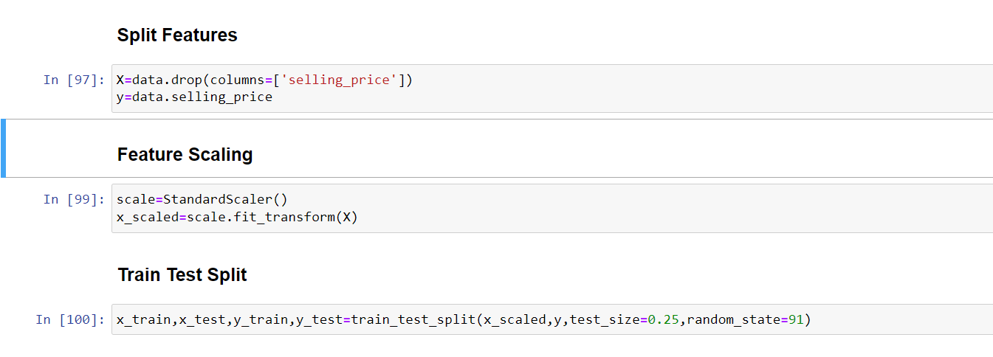
Model Building
Pre processing: Data has splited and done scaling using standard scaler and later on split in train & test.

Slide 14
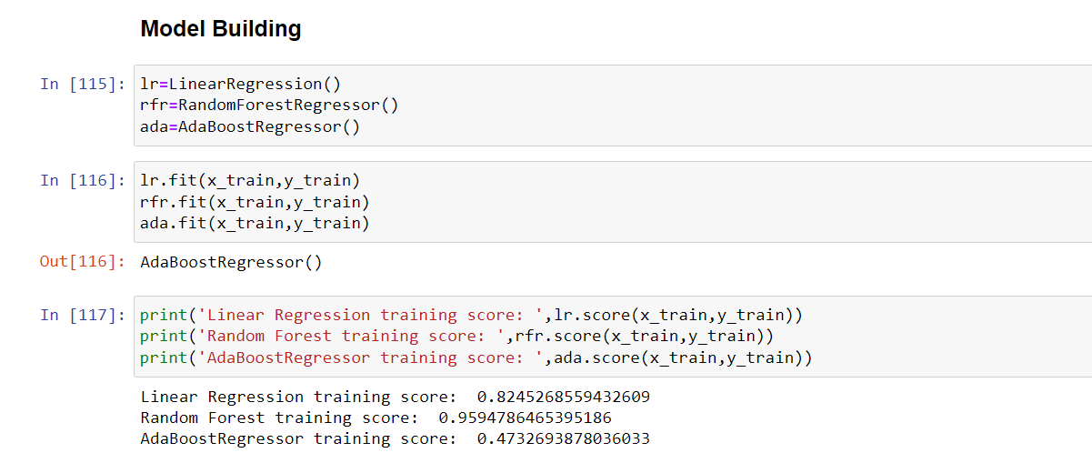
Model Building
Model Trained:Here we used 3 algorithms & trained model on training dataset.

Slide 15
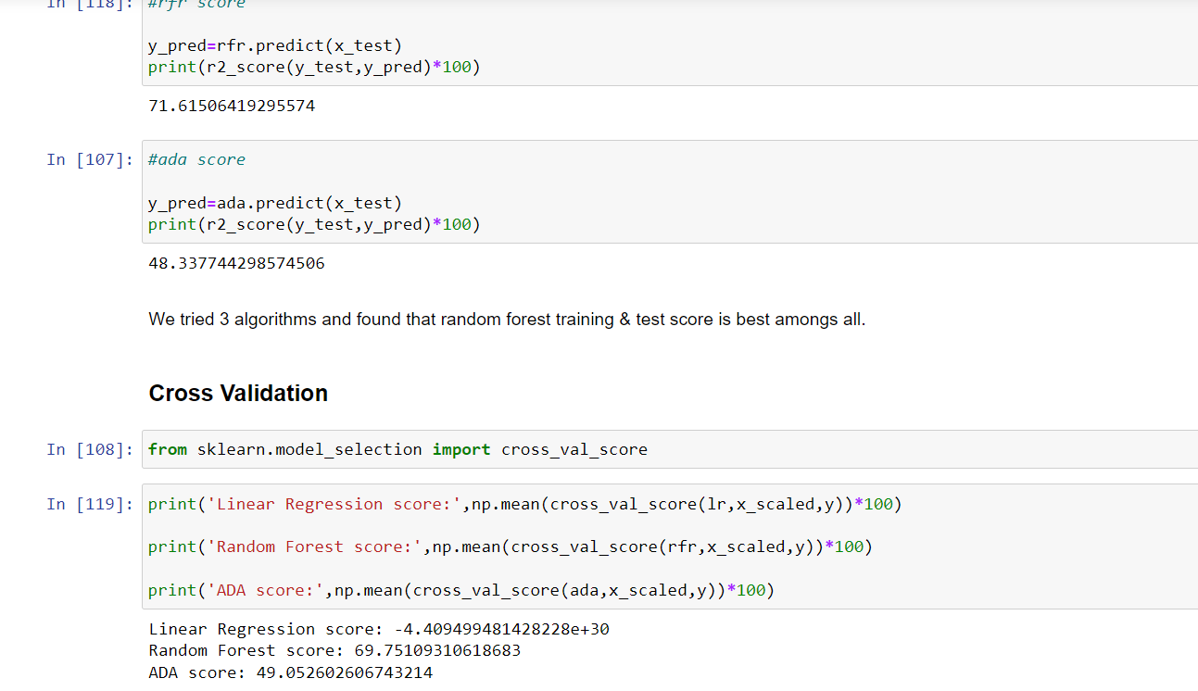
Model Building
Evaluation :We trained all model and evaluate and cross validate and found that Random Forest Regressor algorithm prediction is best.

Slide 16
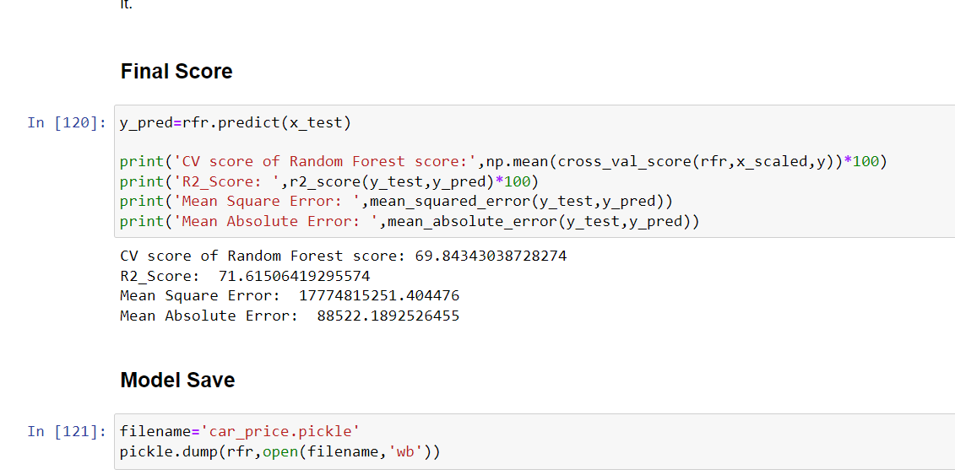
Model Building
Selection Best Model: Here we finalize Random Forest regressor. And we can see final scoring.

Slide 17
Thanks

